Slide 1









Presenters: 4
Cydrex Niño Siton
Leann Hershey Secillano
Kazandra Shane Salao
IMPACT OF COMPUTING IN
Gilbert Sarra
Research and Development

Slide 2



Slide 3


Introduction
The computers are indispensable throughout the research process, only when its on a large scale where the computer becomes way more important.
The use of computers to aid in research and further development of projects
The computers assists the researcher throughout the difference phases of the research process
COMPUTING
-The use or operation of computers.
research and development
-(in industry) work directed toward the innovation, introduction, and improvement of products and processes.
source: trust me bro (sabi ni google)

Slide 4


5 MAJOR PHASES OF THE RESEARCH COMPONENTS

Slide 5

5 MAJOR PHASES OF THE RESEARCH COMPONENTS

Slide 6
5 MAJOR PHASES OF THE RESEARCH COMPONENTS
Conceptual phase
Analytic phase
Empirical phase
Design and Planning phase
Dissemination phase

Slide 7

5 MAJOR PHASES OF THE RESEARCH COMPONENTS
Conceptual phase

Slide 8

Conceptual phase

Slide 9

Conceptual phase
-Involves defining the problem and potential solutions, with computing technology significantly enhancing this by aiding in literature review and hypothesis formulation
How computing aids in this phase:
1. Searching the literature
2. Formulating Hypothesis
3. Utilizing Online resources

Slide 10
Conceptual phase
1. Searching the Literature
Access to Databases- computing enables us to access a wide range online data bases
Advanced Search Tools- search functionalities that allows users to refine their queries
Citation Tracking- involves tracing the references cited
Text Mining and Data Extraction- computational tools can assist in text mining to extract relevant information
1.2. Formulating Hypothesis
Data Analysis and Visualization- involves transforming large datasets into insights
Modeling and Simulation- process of creating computational models
Collaboration Platforms- software tools that facilitates teamwork

Slide 11




Conceptual phase
3. Utilizing Online Resources
Research Networks and Forums- facilitates collaboration and knowledge sharing
Preprint and Repositories- offers early access to rsearch findings to stay updated with latest developments
Machine Learning and Ai- can assist in literature review by identifying emerging trends

Slide 12


Conceptual phase

Slide 13

Conceptual phase
Analytic phase
Empirical phase
Design and Planning phase
Dissemination phase

Slide 14

Design and Planning phase

Slide 15


Design and Planning phase
POV: Me before giving my task to computers
In this phase, researchers plan their methodology, determine the study design, and calculate the sample size. Computing assists by providing powerful software for planning, statistical calculations, and even automated design tools.
POV: Me after giving my task to computers

Slide 16
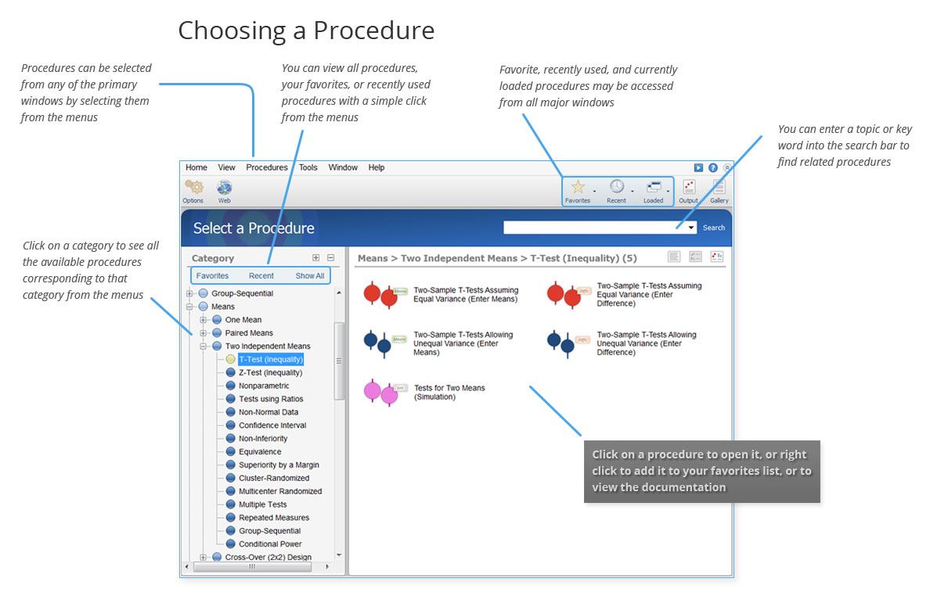
Design and Planning phase
Software Examples:
IBM Statistical Package for the Social Sciences (SPSS) Statistics: A comprehensive statistical software used for data analysis and sample size calculation, ensuring studies are well-designed and statistically sound.

Slide 17

Design and Planning phase

Slide 18


Design and Planning phase
Software Examples:
SurveyMonkey: A popular survey design and data collection tool that allows researchers to create and distribute surveys easily, reaching a large audience.

Slide 19


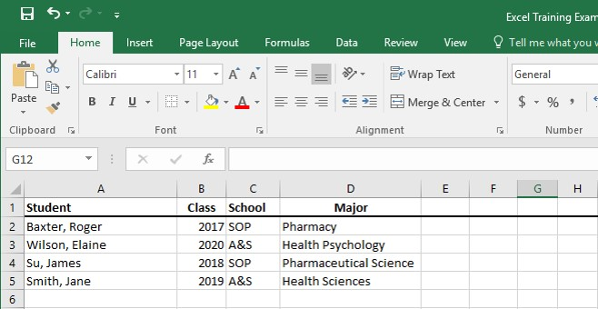
Design and Planning phase
Software Examples:
Microsoft Excel: Project management and organizational tools that help researchers plan timelines, track progress, and ensure all research steps are executed in an orderly fashion.

Slide 20

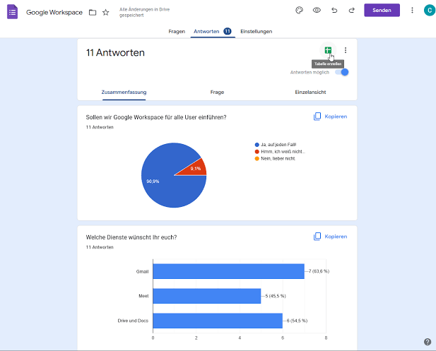
Design and Planning phase
Software Examples:
Google Forms: Google Forms streamlines data collection by allowing researchers to create, distribute, and analyze surveys and questionnaires efficiently.

Slide 21
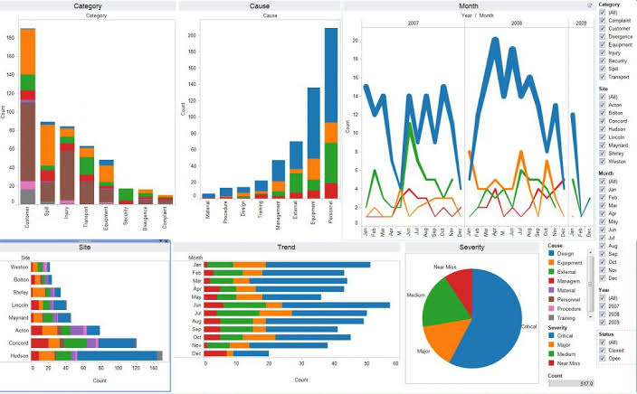
Design and Planning phase
Software Examples:
Tableau: It creates interactive dashboards that help in exploring complex data trends and patterns.

Slide 22

Design and Planning phase

Slide 23
Conceptual phase
Analytic phase
Empirical phase
Design and Planning phase
Dissemination phase

Slide 24

Empirical phase

Slide 25

Empirical phase

Slide 26

Empirical phase
It is consist of collecting and preparing the data for analysis.
It can be stored in computers as word files or excel spread sheets. This has the advantage
of making necessary corrections or editing the whole layout of
the tables if needed, which is not time consuming unlike writing
in paper.
In research studies, the preparation and inputting data is the most labor intensive and time consuming aspect of the work.

Slide 27
Empirical phase

Slide 28
Conceptual phase
Analytic phase
Empirical phase
Design and Planning phase
Dissemination phase

Slide 29
Analytic phase

Slide 30

Analytic phase

Slide 31


Analytic phase
What is the Analytical Phase?
Analytical phase of research is a specific type of research that involves critical thinking skills and the evaluation of facts and information relative to the research being conducted. Fields that apply this in their career include doctors, psychologists, and many more who use analytical research during studies to find the most relevant information. In the analytic phase of all research, patterns and relationships in the data are identified and the research question is answered through the synthesis of numerical and/or narrative data
Types of Analysis
The analytical phase has different approaches to data analysis such as diagnostic analysis, descriptive analysis, predictive analysis, etc. More importantly, in the field of computing has greatly contributed to aiding the process of statistical analysis of the analytical phase of research. Statistical analysis requires a systematic approach to evaluate data by the means of applying statistical techniques (Mean, Mode, Standard Deviation).

Slide 32



Analytic phase

Slide 33

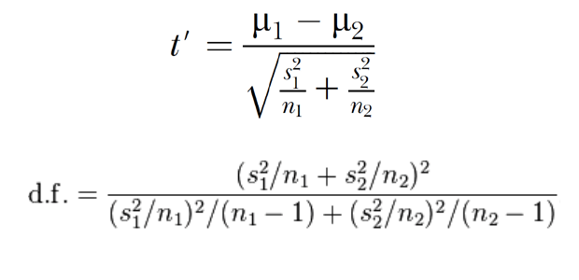
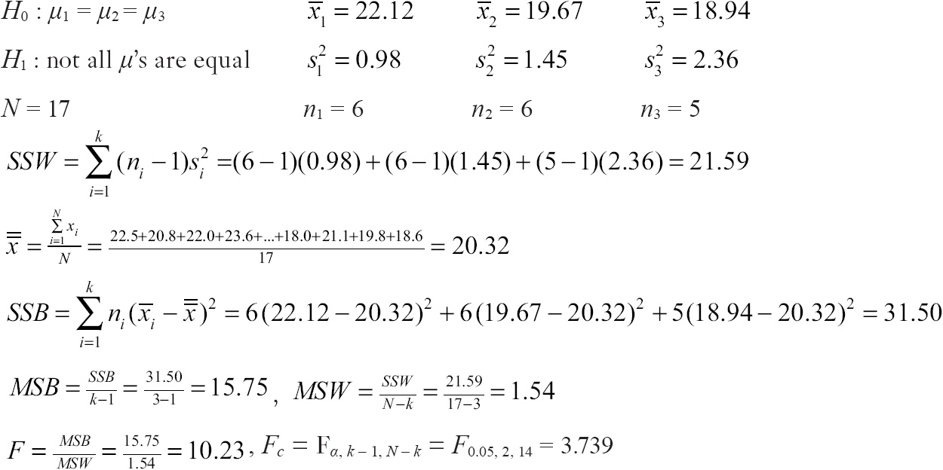
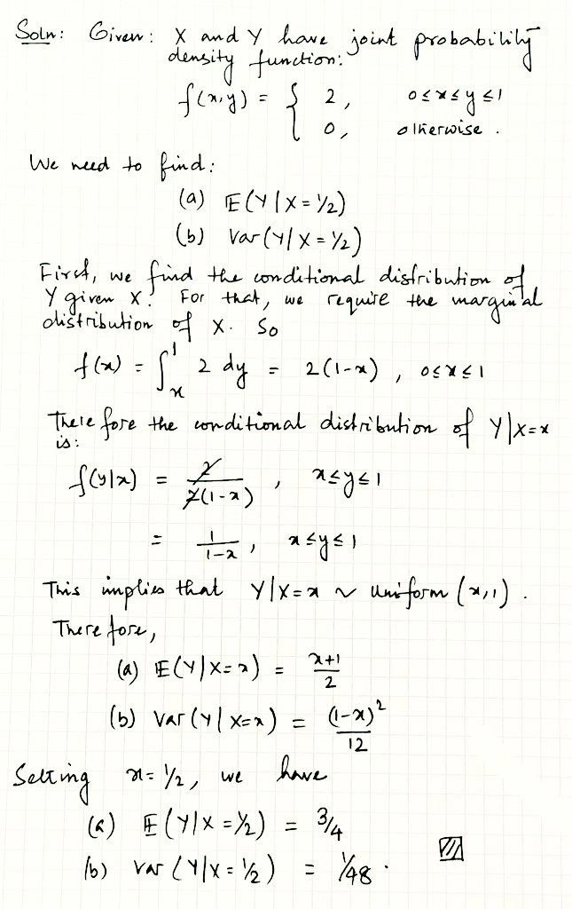
Analytic phase

Slide 34





Analytic phase
Contribution of Computing to Statistical Analysis
The contribution of computing has shifted the mode of solving statistical problems manually to the click of a button. From simple software such as Microsoft Excel, SPSS, XLSTAT, and many to more that make the process convenient and accessible.

Slide 35
Analytic phase
What is Micrsoft Excel?
Excel is a spreadsheet program from Microsoft and a component of its Office product group for business applications. Microsoft Excel enables users to format, organize and calculate data in a spreadsheet. Generally, Excel functions as software for processing numbers, but in detail, this software is also used to create, edit, sort, analyze, and summarize data. In addition, Microsoft Excel also functions to perform arithmetic and statistical calculations so that it can help solve logic and math problems.

Slide 36
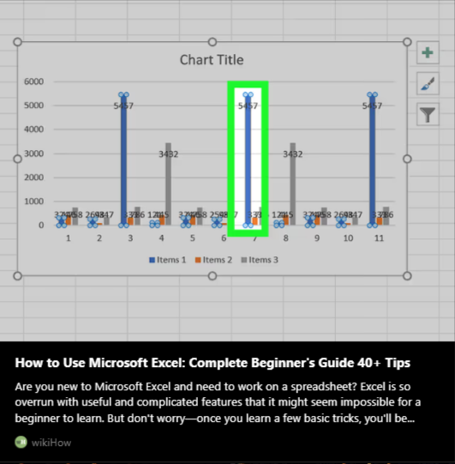

Analytic phase

Slide 37

Analytic phase
What is XLSTAT?
XLSTAT is a powerful yet flexible Excel data analysis add-on that allows 150,000+ users in over 120 countries across the world to analyze, customize, and share results within Microsoft Excel. XLSTAT allows users to analyze, customize, and share data in an easily digestible format, while its counterpart, NVivo, specifically helps researchers organize qualitative data in a more structured way that allows for deeper insights.

Slide 38
Analytic phase
How to use XLSTAT?
To use an XLSTAT function, simply type “=” followed by the name of the function or use the Insert / Function menu of Excel, and choose XLSTAT from the drop-down menu. Finally, select the XLSTAT_Linest function.
How to use XLSTAT functions within an Excel sheet.

Slide 39

Analytic phase
What is SPSS?
SPSS is short for Statistical Package for the Social Sciences, and it's used by various kinds of researchers for complex statistical data analysis. The SPSS software package was created for the management and statistical analysis of social science data. SPSS offers a wide range of analysis methods, such as descriptive statistics, inferential statistics, correlation, regression, ANOVA, chi-square, t-test, and more. You need to consider the type, level, and distribution of your data, as well as the assumptions and requirements of each method.

Slide 40
Analytic phase
What is SPSS?
How to use SPSS: Descriptive statistics - Analyze Data: SPSS - Guides at University of Guelph

Slide 41
Analytic phase

Slide 42

Conceptual phase
Analytic phase
Empirical phase
Design and Planning phase
Dissemination phase

Slide 43

Dissemination phase

Slide 44

Dissemination phase

Slide 45

Dissemination phase
What is the Dissemination Phase?
The dissemination phase is the process of publishing research findings with relevant professionals, practitioners, and to the public. The dissemination phase is just as important as any other phase in the process of research as it enhances the awareness and uptake of research findings. By communicating results, other researchers can obtain useful information to further improve and maximize their work.

Slide 46



Dissemination phase
Types of Dissemination
Traditional ways of disseminating information or researches are through physical prints or word of mouth. At the time, hard copies were only limited to certain locations, and they would have to be maintained in a good condition. Word of mouth is the process of sharing information verbally. This process is the least reliable as changes of the content may vary from one person to another.

Slide 47





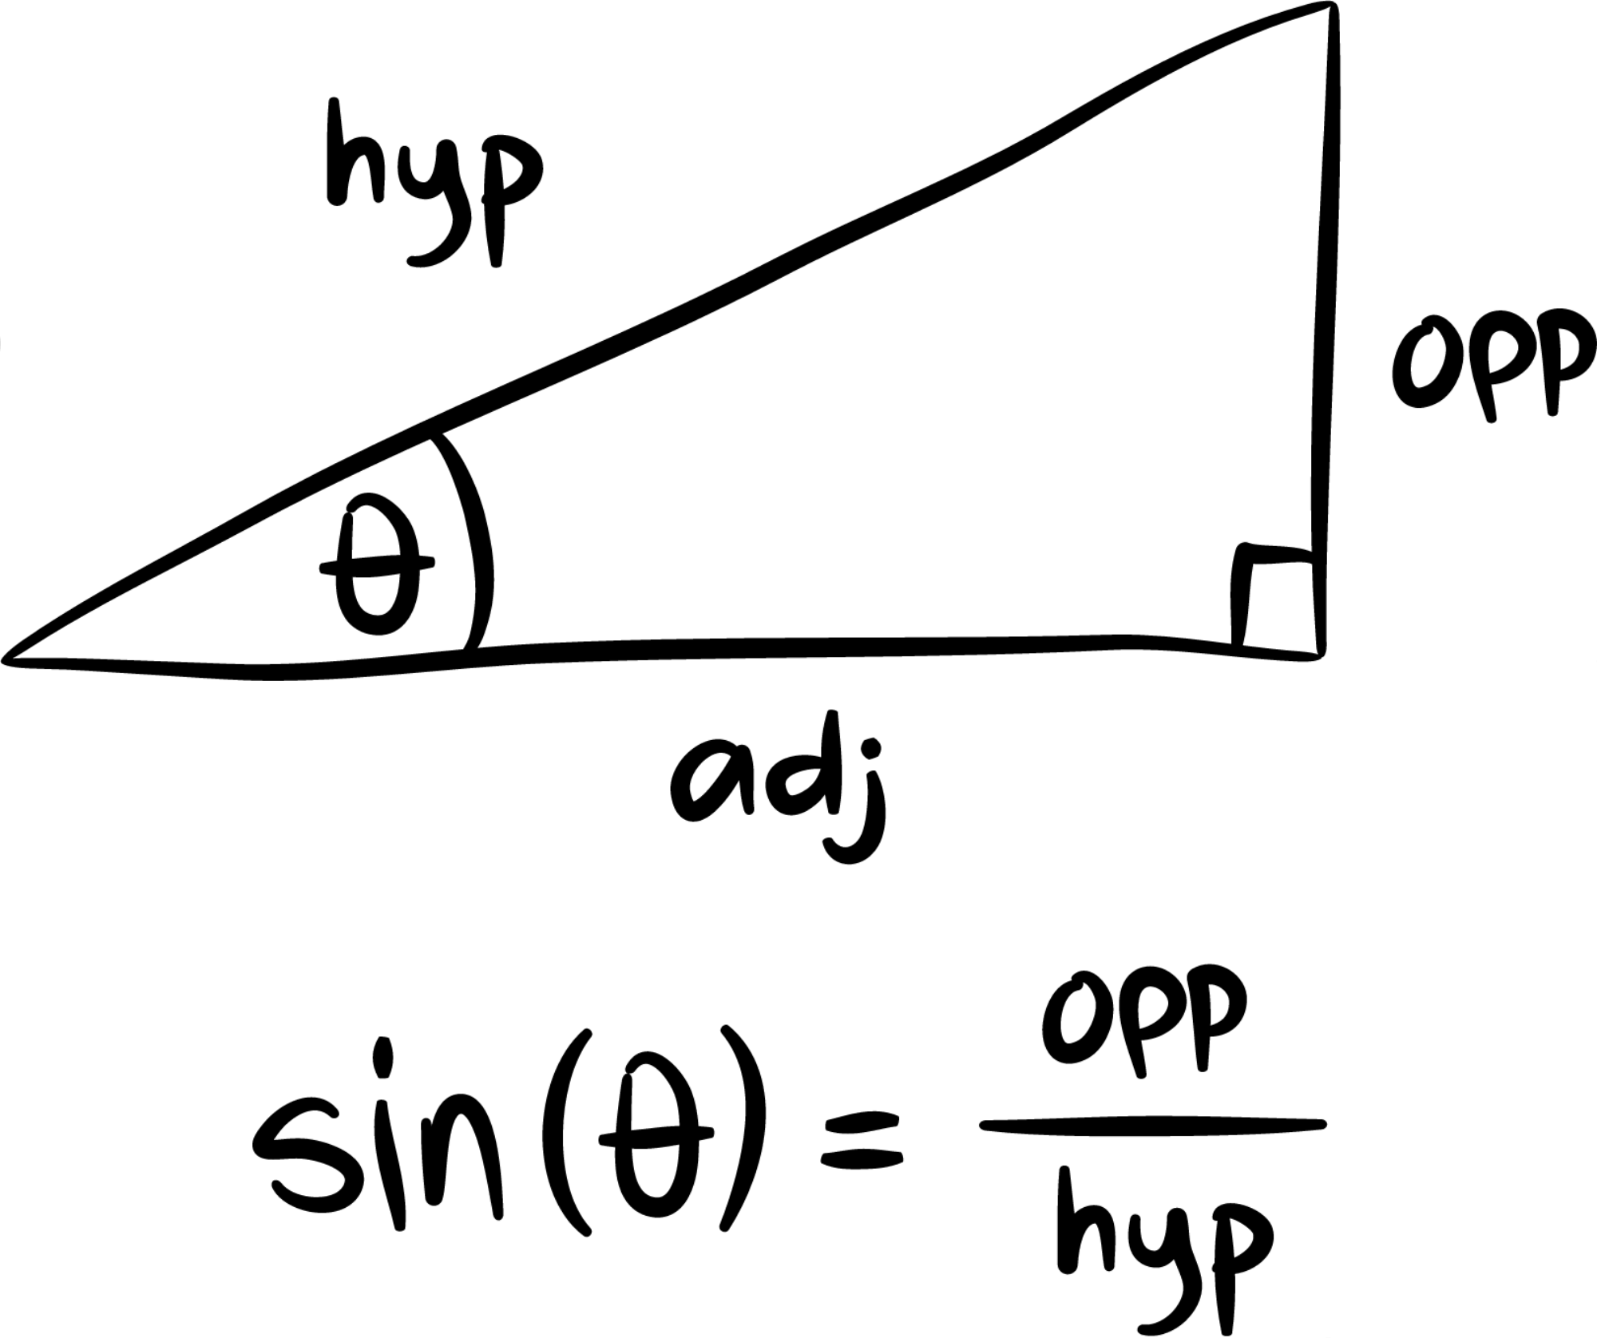
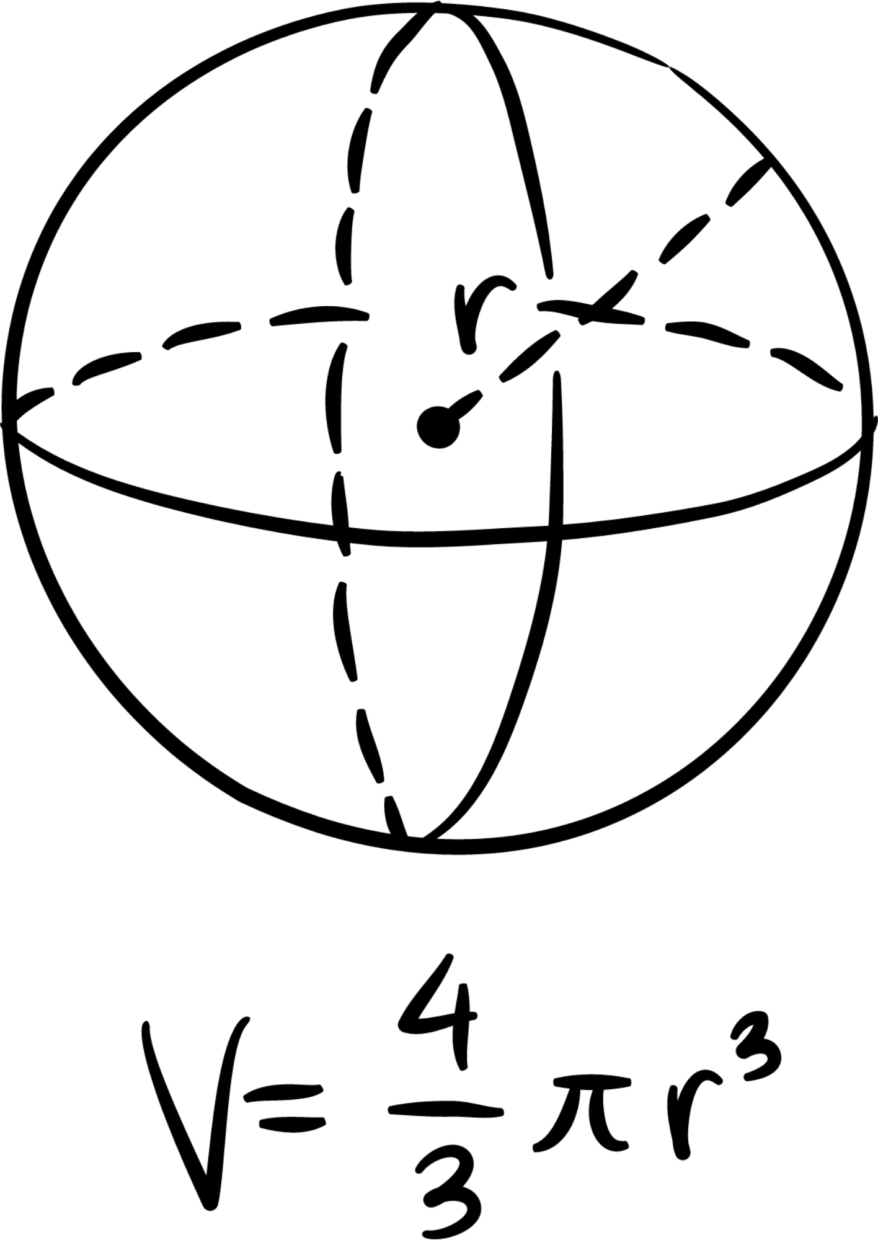


Dissemination phase
Types of Dissemination
Modern ways of disseminating information is via the internet, such as social media platforms, blogs, etc. This makes researches more accessible for all and can be communicated with ease. The downside is with the numerous of information being shared at once, the credibility of the information becomes questionable for professional standards.

Slide 50

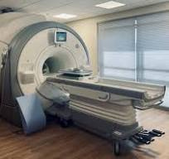

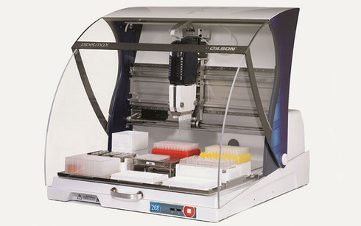
DEVELOPMENTS
CRISPR Gene Editing
MRI Machine
GPS Navigation
(Clustered Regularly Interspaced Short Palindromic Repeats) CRISPR is a cutting-edge technology that enables precise modification of DNA sequences .
MRI (Magnetic Resonance Imaging) machines are advanced medical devices that utilize magnetic fields and radio waves to produce detailed images of the body's internal structures.
GPS (Global Positioning System) navigation is a method that uses a network of satellites to provide precise location and time information for navigation purposes.

Slide 51


Summary
Summary
Computers Aids us in not only through the phases of Human Research, but it’s also helping in the development of technology as time passes.

Slide 52

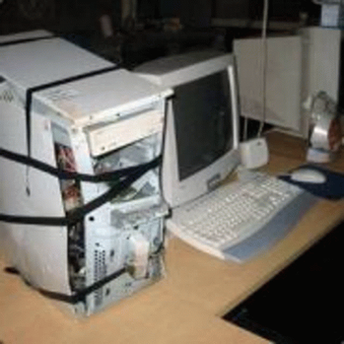

Pros & Cons
Pros:
Cons:
Syempre ako pro
When a computer breaks your data might go with it. A computer is not perfect it can also be bound to generate errors and/or corruption of files
computers are fast and reliable
computers do most of the job
chat gpt :D

Slide 53




THE END!!!!!

